Slide 1

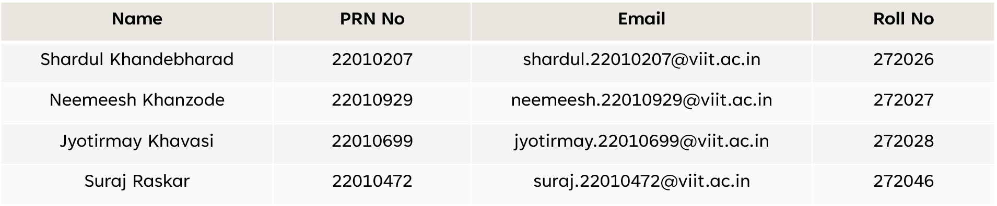
ADUA21203:Microprocessors
A project on ‘Page Replacement Algorithm: Least Recently Used’
ACADEMIC YEAR: 2021-22 SEMESTER: III BATCH: B2
Submitted for fulfilment of Project Based Learning by :

Slide 2

INDEX
Paging
Brief of other Replacement Algorithms.
LRU in detail.
Demonstration of LRU algo. in C.
Applications of LRU/Replacement algos.

Slide 3
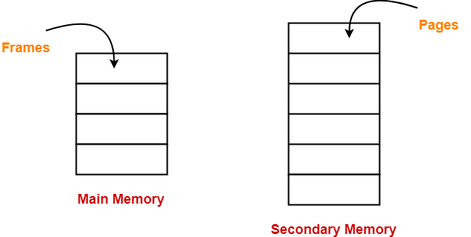
Paging
Paging is a fixed size partitioning scheme.
In paging, secondary memory and main memory are divided into equal fixed size partitions.
The partitions of secondary memory are called as pages.
The partitions of main memory are called as frames.

Slide 4
Page Fault
When a page referenced by the CPU is not found in the main memory, it is called as a page fault.
When a page fault occurs, the required page has to be fetched from the secondary memory into the main memory.

Slide 5
Brief of other Replacement Algorithms
FIFO Page Replacement Algorithm
LIFO Page Replacement Algorithm
LRU Page Replacement Algorithm
Optimal Page Replacement Algorithm
Random Page Replacement Algorithm

Slide 6
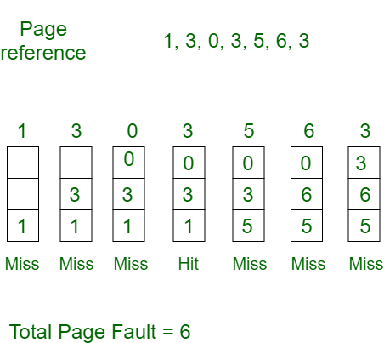
FIFO Page Replacement Algorithm
FIFO - First In First Out
Simplest Page Replacement Algorithm
In this algorithm, the operating system keeps track of all pages in the memory in a queue, the oldest page is in the front of the queue. When a page needs to be replaced page in the front of the queue is selected for removal.
Page reference string 1, 3, 0, 3, 5, 6 with 3 page frames

Slide 7
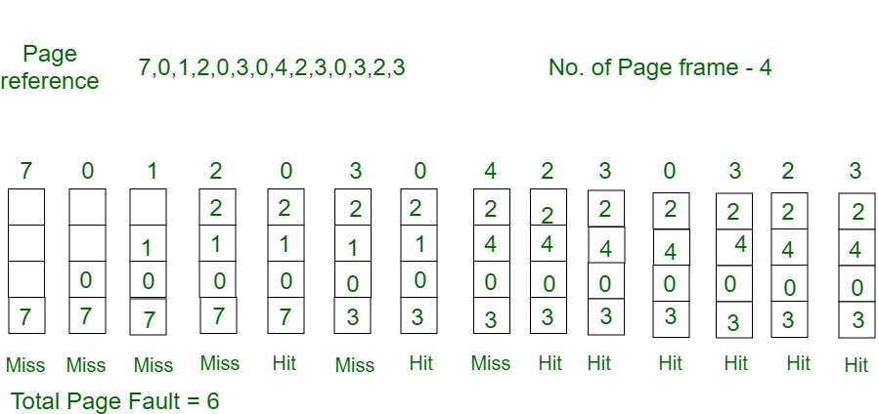
Optimal Page replacement
In this algorithm, pages are replaced which would not be used for the longest duration of time in the future.
Page reference 7, 0, 1, 2, 0, 3, 0, 4, 2, 3, 0, 3, 2, with 4-page frame

Slide 8
LIFO Page Replacement Algorithm
Works on the principle of Last in First out.
It replaces the newest page that arrived at last in the main memory.
It is implemented by keeping track of all the pages in a stack.

Slide 9
Random Page Replacement Algorithm
Replaces the page randomly.
This Algorithm can work like any other page replacement algorithm that is LIFO, FIFO, Optimal, and LRU.

Slide 10

LRU Page Replacement Algorithm In the Least Recently Used (LRU) page replacement policy, the page that is used least recently will be replaced. If a process requests for page and that page is found in the main memory then it is called page hit, otherwise page miss or page fault
Advantages –
It is open for full analysis.
Free from Belady’s Anomaly.
Efficient.
Disadvantages –
It require additional DS to be implemented.
Requires hardware support

Slide 11
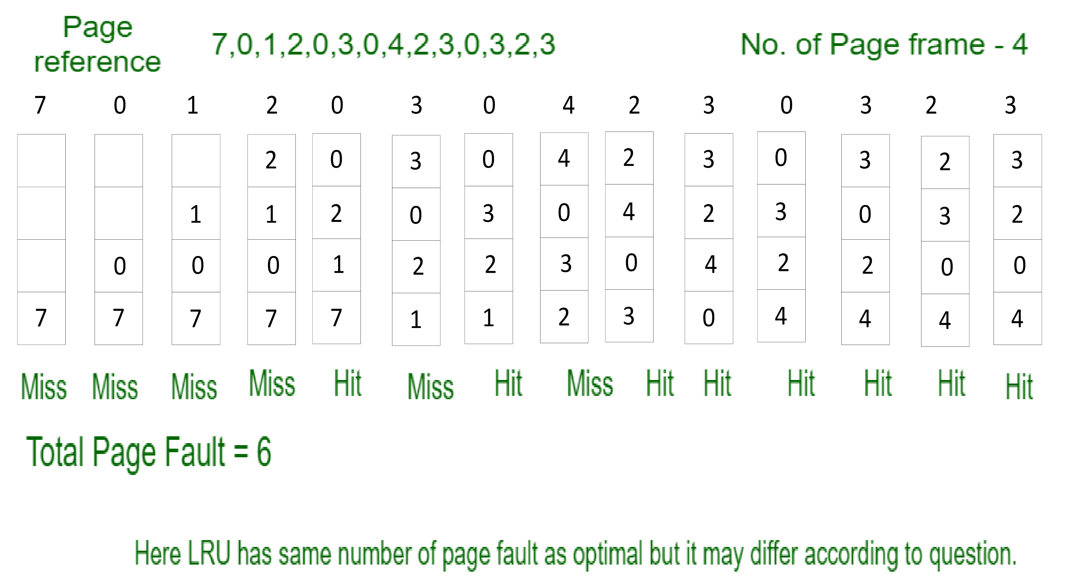
LRU Page Replacement Algorithm
LRU – Least Recently Used
In this algorithm the page will be replaced which is least recently used.
MRU
LRU

Slide 12
Demonstration
Input:
Frame Size: 8
Number of pages: 40
Pages(Separated by space): 0 2 0 2 7 9 2 0 0 8 5 2 2 0 0 7 6 5 4 1 2 0 0 2 0 5 0 1 2 0 0 3 0 9 1 0 2 0 0 1
If we change frame size to 10 keeping same pages as input. Also, if we change frame size to 5 keeping same pages as input
LRU Implementation

Slide 13
Applications of LRU/Replacement algos.
Keep the most recently used apps at the front of the list.
When the user opens an app not in the list, add this app to the front of the list.
If the list is full, remove the least recently used app from the list
Samsung's TouchWiz
Shows recently used apps on home screen

Slide 14

Thank You

